Slide 1
Relational Database Design by ER and ER-to-Relational Mapping

Slide 2
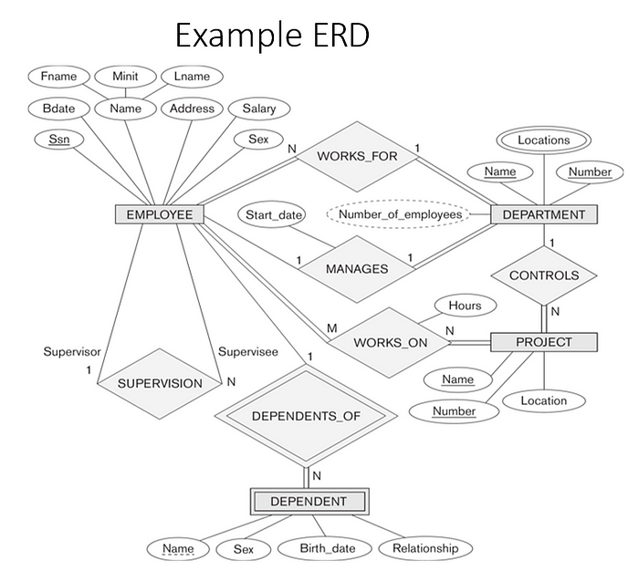
E-R DIGRAM FOR COMPANY DATABASE

Slide 3
ER-to-Relational Mapping Algorithm :
Step 1: Mapping of Regular Entity Types
Step 2: Mapping of Weak Entity Types
Step 3: Mapping of Binary 1:1 Relation Types
Step 4: Mapping of Binary 1:N Relationship Types.
Step 5: Mapping of Binary M:N Relationship Types.
Step 6: Mapping of Multivalued attributes.

Slide 4
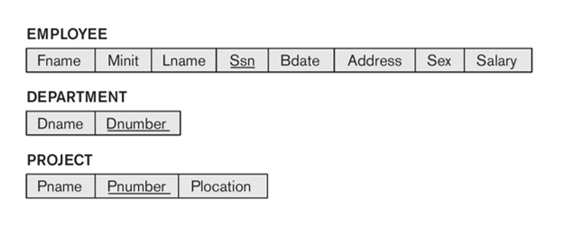
Step 1: Mapping of Regular Entity Types
Step :
1) Create strong entitles from diagram and then create corresponding relation(table) that include all simple attribute.
2) Choose one of the key attributes as primary.If composite, the simple attributes together form the primary key
3) Any remaining key attributes are kept as secondary unique keys.
From above diagram we get result as :

Slide 5
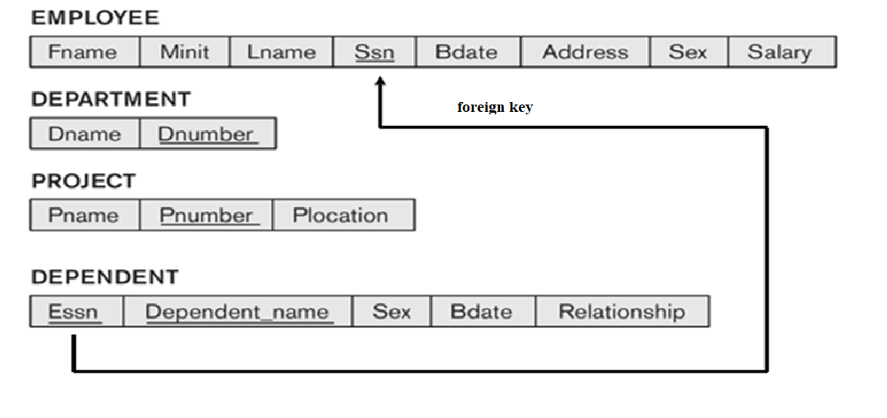
Step 2: Mapping of Weak Entity Types
Process:
i) For each weak entity type, create a separate relation that includes all the simple attributes
ii. Add as a foreign key all of the primary key attribute(s) in the entity to the owner entity type
iii. The primary key is the combination of all the primary key attributes from the owner and the partial key of the weak entity.

Slide 6
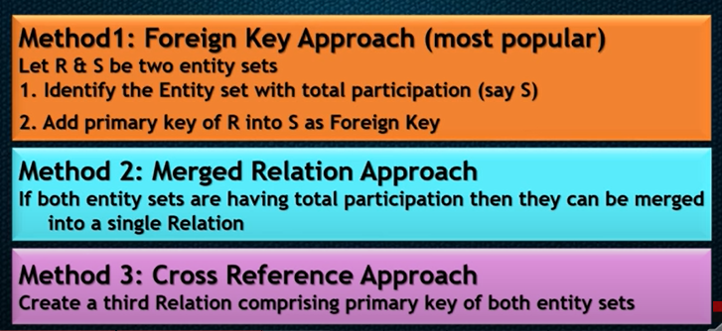
3) Mapping 1:1 relationship type :

Slide 7
Step 3: Mapping of 1 Relation Types
We need to figure out the entities from ER diagram for which there exists a 1-to-1 relationship.
The entities for which there exists a 1-to-1 relationship, choose one relation(table) as S, the other as T. Better if S has total participation (reduces the number of NULL values).
Then we need to add to S all the simple attributes of the relationship if there exists any.
After that, we add as a foreign key in S the primary key attributes of T.
For the given ER-Diagram there exists a 1-to-1 relationship between Employee and Department entity.
Here Department has total participation therefore consider it as relation S and Employee as relation T.

Slide 8
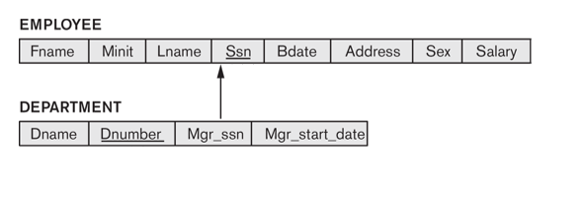
Step 3: Mapping of Binary 1:1 Relation Types

Slide 9
Step 4: Mapping of 1:N Relationship Types.
For each regular binary 1:N relationship type R, identify the relation S that represent the participating entity type at the N-side of the relationship type.
Include as foreign key in S the primary key of the relation T that represents the other entity type participating in R.
Include any simple attributes of the 1:N relation type as attributes of S.
Example: 1:N relationship types WORKS_FOR, CONTROLS, and SUPERVISION in the figure.
For WORKS_FOR we include the primary key DNUMBER of the DEPARTMENT relation as foreign key in the EMPLOYEE relation and call it DNO.

Slide 10
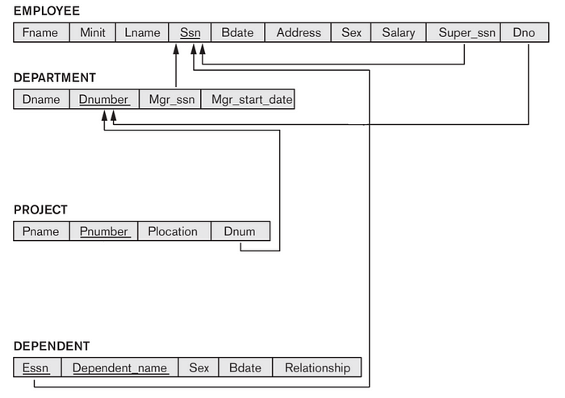
Step 4: Mapping of 1:N Relationship Types.

Slide 11
Step 5: Mapping of M:N Relationship Types.
Create third relation containing Primary key of both entity sets and descriptive attributes,
Here employee ,project describe this relation and work on maintain M:N relation with project with hour entity.
P-Key of employee is ssn and primary key of project is P_Number along with descriptive entities.
So Work_On contain SSN of employee ,P_number of Project and Hour of Work_On.
SSN and P_no from Work_On is work as Foreign key and as composite key .So finally Work_On is a composite key .

Slide 12
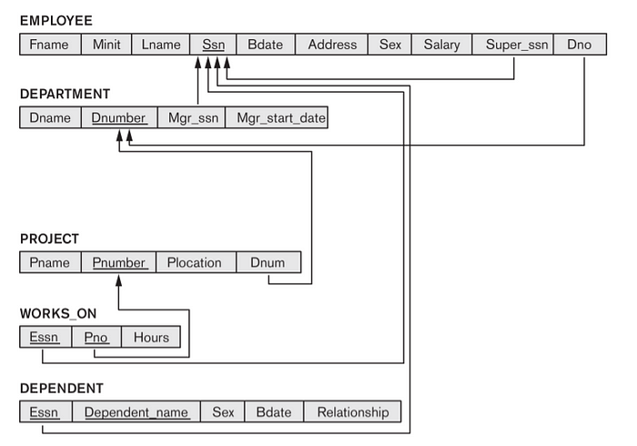
Step 5: Mapping of M:N Relationship Types.

Slide 13
Step 6: Mapping of Multivalued attributes.
For each multivalue attribute create separate relation.
Add Primary Key of entity set in new relation as foreign key.
Foreign key and multivalue attribute will become composite key.
From diagram Location from Department is multivalue attribute.

Slide 14
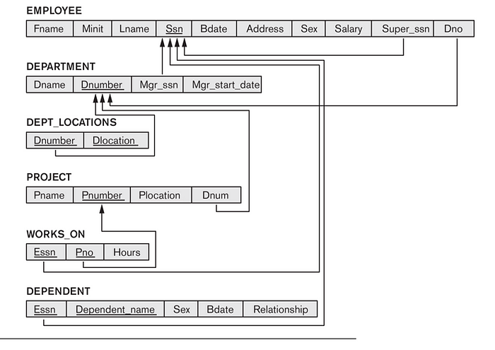
Step 6: Mapping of Multivalued attributes.

Slide 15
DATA TYPES IN DBMS
There are six types of inbuilt data types
Scalar data types : – Used to store scalar values like numbers, decimals etc.
Composite data types : – It is combination of other datatypes usually scalar datatypes.
Reference data types : – Used to store the information about another data type. It can be referred as pointers in C.
LOB data types : – Used to store large objects like images, videos etc.
Unknown Column types : – when column types are not known, this data type is used.
User Define data types : – these datatypes are defined by the developer while coding using the above base data types. They define new datatypes to ease their coding. This is can be considered as composite data type too.

Slide 16
Data Types : Scalar data types
These datatypes are used to store the numeric column values or numeric variables.
This column can have only numbers in it. We cannot insert any date or alphabets into it.
There are four types of Scalar datatypes – Character, Numeric, Date/Time and Boolean.
Character Data type: –This type of datatype is used to store alpha-numeric values like alphabets as well as numbers and special characters.
CODE:
CREATE TABLE STUDENT (STD_NAME CHAR (15), ADDRESS VARCHAR2 (50));

Slide 17
Datatype | Sub-Datatype | Description |  | Storage
Character Data Type | CHAR | Used to store fixed length of string or value. |  | 32767 bytes
 | CHARACTER | This is same as CHAR, and both are used alternatively. CHAR is most commonly used. |  | 32767 bytes
 | VARCHAR2 | This is also similar to CHAR, where strings are stored. This datatype will define fixed length but the actual length of the string will be the length of the value i.e.; if VARCHAR2(10) is defined on column NAME and if NAME has one value ‘James’, then the length of that column value is 5, instead of 10. In the case of CHAR, it will be always 10; the space after the names will be filled with NULLS. |  | 32767 bytes
 |  | VARCHAR2 Subtypes: Following sub type defines same length value.
 |  | Sub Data types | Description
 |  | STRING | they are similar to VARCHAR2, only the name difference
 |  | VARCHAR
 | NCHAR | Stores National Character data (Unicode) within the specified length. |  | 32767 bytes
 | NVARCHAR2 | This is similar to VARCHAR2, but used to store unicode values. |  | 32767 bytes
 | RAW | This datatype is used for such data like music, video, graphics etc where conversion of datatype between different systems is not required. They are representing in bits and bytes. |  | 32767 bytes
 | LONG | Used to store variable length of strings with backward compatibility. We can store very large data in it. But it is usually recommended to use LOB when there is a need for LONG. Because LOB has less restriction on storage and conversions, and have more features added when there is a new release. LONG columns are preferred in SELCT or UPDATE statements than tables. |  | 32760 bytes
 | LONG RAW | This is combination of LONG and RAW datatypes. |  | 32760 bytes
 | ROWID | The ROWID data type represents the actual storage address of a row. And table index identities as a logical ROWID. This data type used to store backward compatibility.
 | UROWID[(size)] | The UROWID data type identifies as universal ROWID, same as ROWID data type. Use UROWID data type for developing newer applications. |  | 4000 bytes

Slide 18
Numeric Datatypes: – .
Stores different types of numeric data – numbers, decimals etc. Depending on the type we have different sub types of numeric datatypes.
CODE:
CREATE TABLE STUDENT (STD_ID NUMBER (8), ADDRESS VARCHAR2 (50));

Slide 19
Datatype | Sub-Datatype | Description |  | Storage
NUMERIC DATA Types | NUMBER (p, s) | NUMBER data type used to store numeric data. Storage Range : Precision range(p) : 1 to 38 and Scale range(s) : -84 to 127
 |  | NUMBER Subtypes: This sub type defines different types storage range.
 |  | Sub Data types | Description | Max Precision
 |  | INTEGER | This data types are used to store fixed decimal points. You can use based on your requirements. | 38 digits
 |  | INT |  | 38 digits
 |  | SMALLINT |  | 38 digits
 |  | DEC |  | 38 digits
 |  | DECIMAL |  | 38 digits
 |  | NUMERIC |  | 38 digits
 |  | REAL |  | 63 binary digits
 |  | DOUBLE PRECISION
 |  |  |  | 126 binary digits
 |  | FLOAT
 |  |  |  | 126 binary digits
 | BINARY_INTEGER | BINARY_INTEGER data type store positive and negative values. They require less storage space compare of NUMBER data type values. Storage Range: from -2147483647 to 2147483647.
 |  | Sub Data types | Description
 |  | NATURAL | Only Positive values are stored.
 |  | POSITIVE
 |  | NATURALN | NULL values are not stored in this datatype. Only non-null positive values are allowed.
 |  | POSITIVEN
 |  | SIGNTYPE | SIGNTYPE allow only -1, 0, and 1 value.
 | PLS_INTEGER | PLS_INTEGER data type used to store signed integers data. They require less storage space compare of NUMBER data type value. Storage Range: from -2147483647 to 2147483647. PLS_INTEGER data type gives better performance on the data. PLS_INTEGER perform arithmetic operation faster than NUMBER / BINARY_INTEGER data type.

Slide 20
3) Date / Time Datatypes
These datatypes are used to store date and timestamps in the columns and variables.

Slide 21
Datatype | Sub-Datatype | Description |  | Range
Date / Time Datatype | DATE | DATE data type stores valid date-time format with fixed length. Starting date from Jan 1, 4712 BC to Dec 31, 9999 AD. |  | Jan 1, 4712 BC to Dec 31, 9999 AD
 | TIMESTAMP | Stores valid date with year, month, day and time with hour, minute, second
 |  | Type | TIMESTAMP Type
 |  | 1 | Syntax: TIMESTAMP [(fractional_seconds_precision)] fractional_seconds_precision optionally specifies the number of digits in the fractional part of the second precision. Range from 0 to 9. The default is 6.
 |  |  | Example: TIMESTAMP ‘2014-04-13 18:10:52.124’
 |  | 2 | Syntax: TIMESTAMP [(fractional_seconds_precision)] WITH TIME ZONE
 |  |  | Example: TIMESTAMP ‘2014-04-13 18:10:52.124 +05:30’
 |  |  | WITH TIME ZONE specify the UTC time zone. Following two values represent the same instant in UTC.
 |  |  | TIMESTAMP ‘1999-04-15 8:00:00 -8:00’ (8.00 AM Pacific Standard Time) or
 |  |  | TIMESTAMP ‘1999-04-15 11:00:00 -5:00’ (11:00 AM Eastern Standard Time) both are same.
 |  | 3 | Syntax: TIMESTAMP [(fractional_seconds_precision)] WITH LOCAL TIME ZONE
 |  |  | Example: COL_NAME TIMESTAMP(3) WITH LOCAL TIME ZONE;
 |  |  | WITH LOCAL TIME ZONE specifies when you insert values into the database column, value is stored with the time zone of the database.
 |  |  | The time-zone displacement is not stored in the column. When you retrieve value from Oracle database, returns it according to your UTC local time zone.

Slide 22
Boolean Datatypes
It is used to store Boolean values – TRUE or FALSE. It can also store NULL and is considered as unsigned Boolean variable. We cannot compare Boolean columns of two tables.
CODE:
SECT * FROM EMP
SELECT * FROM EMP WHERE IS_EMPLOYED = (SELECT IS_EMPLOYEED
FROM EMP WHERE EMP_NAME = ‘John’); -- this query is not valid

Slide 23
SQL Commands
DDL- Data Definition Language : changes are saved.
DML- Data Manipulation Language: Changes are not saved.
DCL- Data Control Language: grant and take authority from Db user.
TCL-Transaction Control Language: declare changes made by other commands.

Slide 24
SQL Commands
DDL Commands | DML Commands | DCL Commands
Create | Insert | Commit
Alter | Update | Roll back
Drop | Delete
Grant | Select
Revoke

